Slide 1
DNS Spoofing
Sam Pourcyrous
Zubair Baig

Slide 2
What is DNS?
Is a hierarchal distributed system for computers or any resource connected to the internet to find other computers or services
It maps domain names to their IP addresses
Notes:
Is a hierarchal distributed system for computers or any resource connected to the internet to find other computers or services
The way it finds these resources is by mapping the domain name to their IP addresses
Whenever your computer wants to contact www.google.com for example, the DNS server is searched. The cache in the DNS server is searched first, If the mapping was not found for that domain in the DNS cache, it is reclusively searched until found in the authoritative server. This means that the information is from the source, which is the administrator, and it is the most up to date mapping of the domain name

Slide 3
DNS Namespace
Notes:
Before I get into the process of how the DNS server works, we have to talk about the DNS Namespace. This is a logical tree structure that is broken up into groups. This makes it easy to find the final fully qualified domain name IP address mapping. The process is shown in the next slide

Slide 4
Notes:
The computer sends a domain to the DNS server. If a mapping was found in its cache, the client is sent back the IP address and it can now resolve the IP address and go to the website. If it wasn’t found in the cache it has to do a recursive search as mentioned before. The DNS servers are found by searching through the fully qualified domain name from right to left, getting the server for each domain level. When the final IP address is found, the client resolves that address and then can connect to the website. ISP’s typically provide recursive and caching name servers for their customers. Any part of the domain can be cached so not every name server would need to be accessed when making a request.

Slide 5
Why do we need DNS?
Makes administration much easier
It maps easy to remember domain names to their IP addresses
You can have multiple computers with the same name because they are under other fully qualified domain names
Notes:
Before DNS there was just a host file on the computer. Whenever a change was made to a domain, the host file was changed and had to be copied to multiple computers. This was not practical especially since the number of computers were growing and you would have to copy a single host file to thousands of computers for a simple change. This made it hard to ensure clients had the latest copy of the host file. By distributing the names this gave more administrative control over domain names and it helped resolve domain names to their respective IP addresses without the need of updating anything on your computer.
It is also easier to remember names rather than IP addresses. e.g facebook.com easier to remember than 69.171.230.68
You can have multiple computers with the same name because they are under other fully qualified domain names

Slide 6
DNS Hierarchy
DNS Levels
Mapping Example
Host File
Local DNS
Public DNS
Notes:
When a domain name needs to be translated, the first thing the computer looks at is the host file. This is a local file on the computer that contains mappings between IP addresses and domain names.
If the domain is not found, the Local DNS is then searched which is usually stored on a router on a home network.
If the domain is not found their either, the public DNS is then searched which contains the authoritative ip address of the domain.

Slide 7
DNS Demo
Notes:
Nslookup demo
DNS Spoofing vs cache poisoning:
DNS Spoofing is a broad category of falsifying DNS records in some way (man in the middle, acting like a base station and lying about which DNS server to use)
Cache poisoning potentially affects many end users using the same cache from a DNS server. It’s a type of DNS spoofing

Slide 8
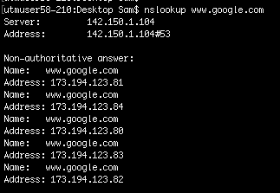

Slide 9
Vulnerabilities ➔ Exploits in DNS
No verification of data received from DNS ➔ Man-in-the-middle attacks
Response from DNS Server in unencrypted UDP packet ➔ Packet Sniffing
Caching vulnerabilities related to resource records (RR) ➔ Cache Poisoning
Dynamic Host Configuration Protocol (DHCP) ➔ DDoS
Usage style ➔ DDoS
Notes:
Vulnerability vs exploits (the use of the vulnerability to achieve an undesired and unintended outcome)
There is no way of authenticating/verifying data returned from a DNS
Because within DNS, no way to communicate to servers how to authenticate data being sent to clients
Attacker can easily spoof a DNS response packet with the source IP of the DNS server, destination port numbers etc
Legitimate request has to accept any response from this attacker.
Via Packet sniffing, a crafted response can be sent to the requester before the real one comes in from the DNS. A compromised router is usually perfectly situated to sniff these responses and pass down a fake one.
Caching is utilized by DNS to reduce response/access times. However, the cache can be attacked if it stays stale for too long.
Resource records are the ‘database entries’ defining the type and content of data in DNS. These RRs can be of different types. A few of them can be particularly vulnerable, like CNAME (canonical name). In the response of RRs for CNAME, an attacker can inject falsified data into the “Additional section” and thus introduce arbitrary DNS names which will then be looked up in a cache hit.
DHCP uses Dynamic updating to add and delete RRs. This is usually done on the primary server for that area. However there is no real authentication of these updates other than IP address, which can be easily spoofed causing Ddos if done repeatedly or even deletion of RRs prematurely etc.
100,000 queries per second at root servers, 60-85% were bogus. A lot of times, if the resolver isn’t set up properly (routing issues), the response from the DNS server can get lost and it gets a request again from the same end point resulting in increased load.

Slide 10
DNS Spoofing Demo

Slide 11
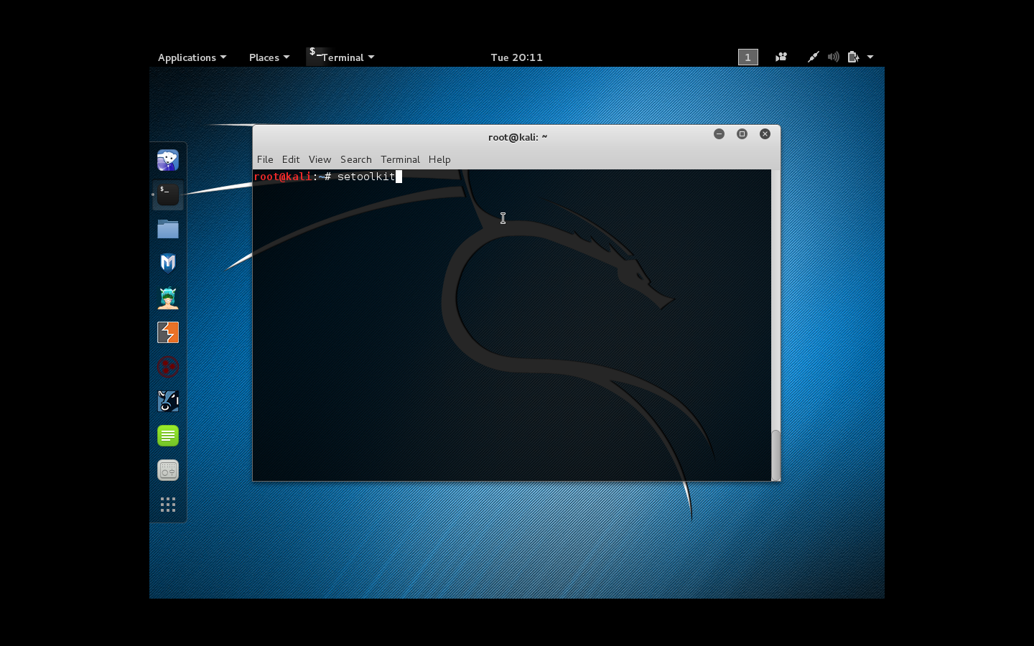

Slide 14
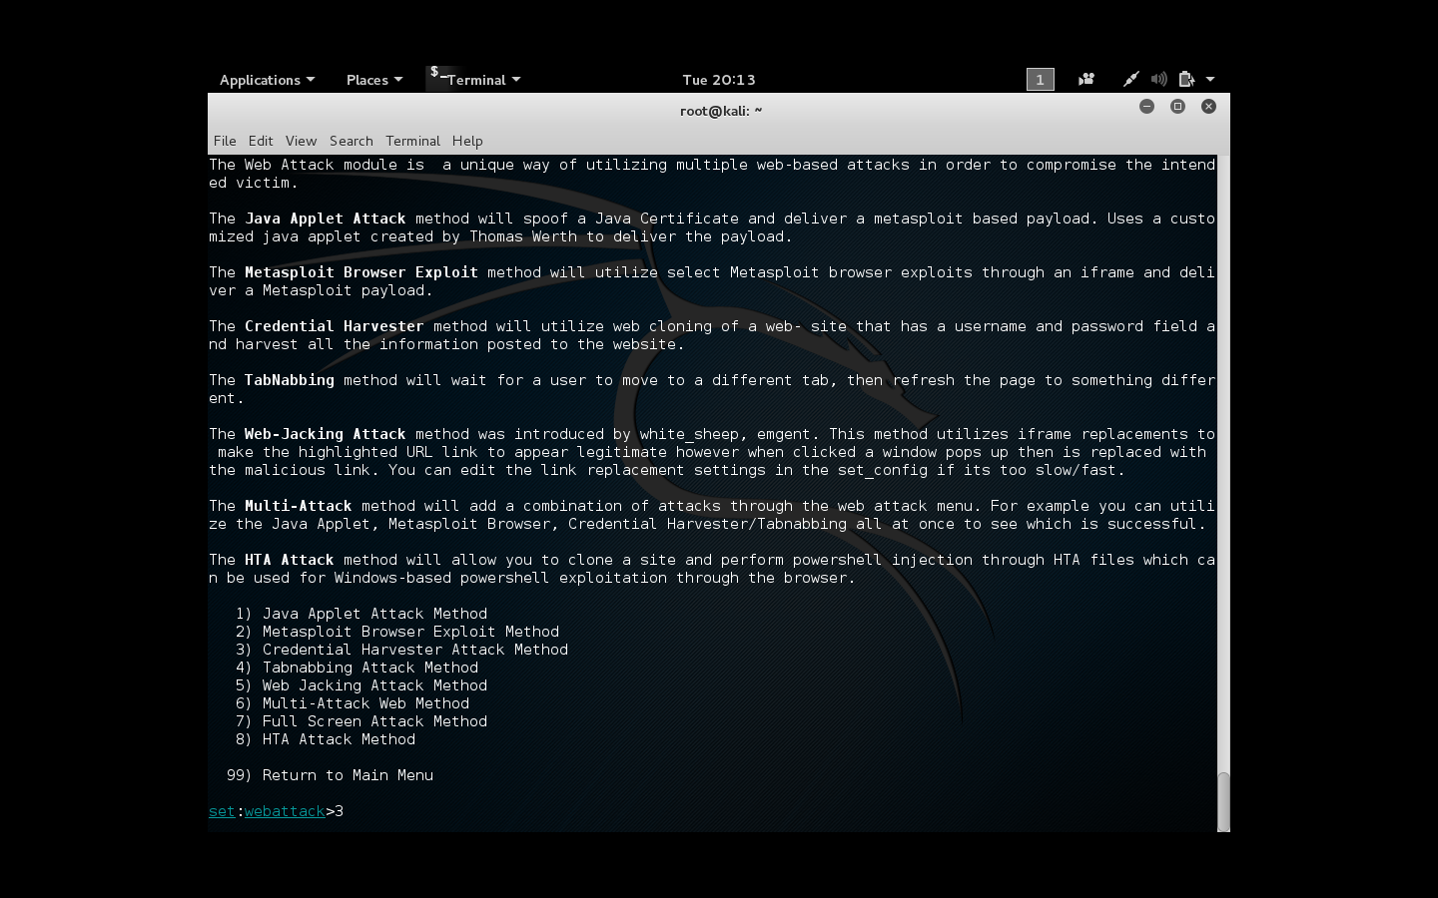

Slide 15
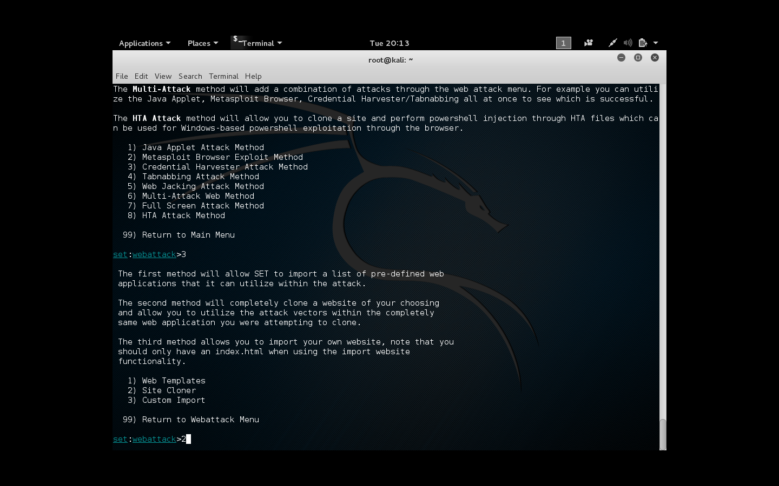

Slide 16
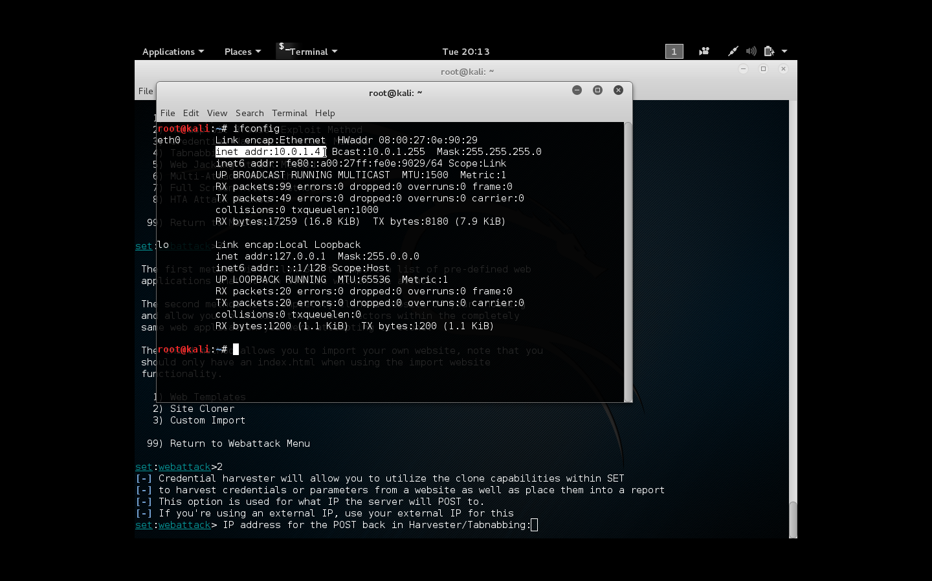

Slide 17
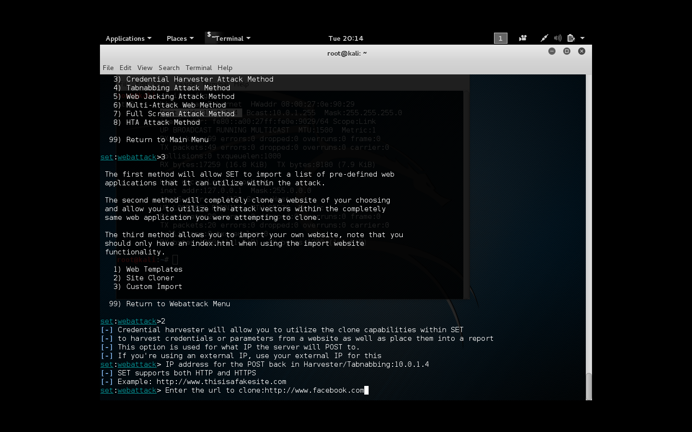

Slide 18
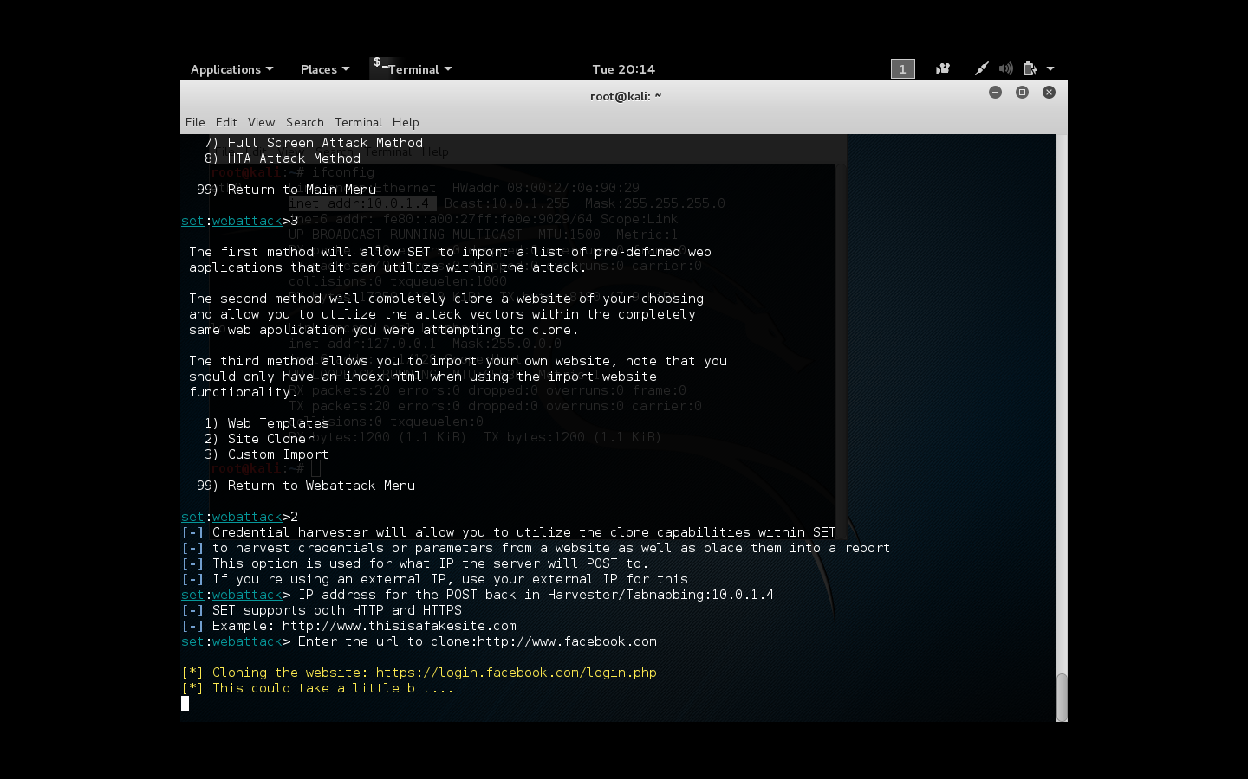

Slide 19
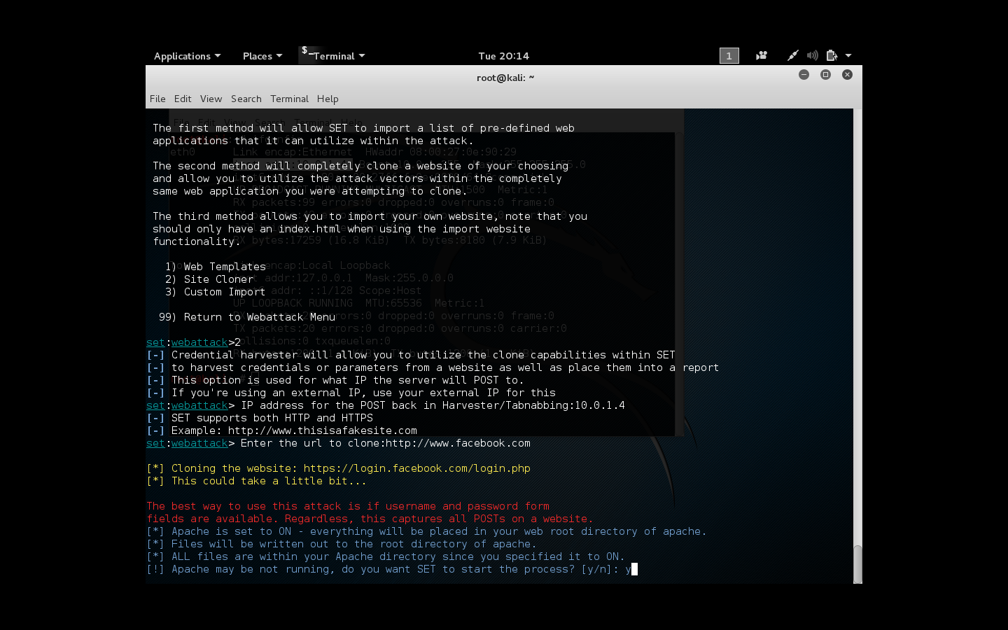

Slide 20
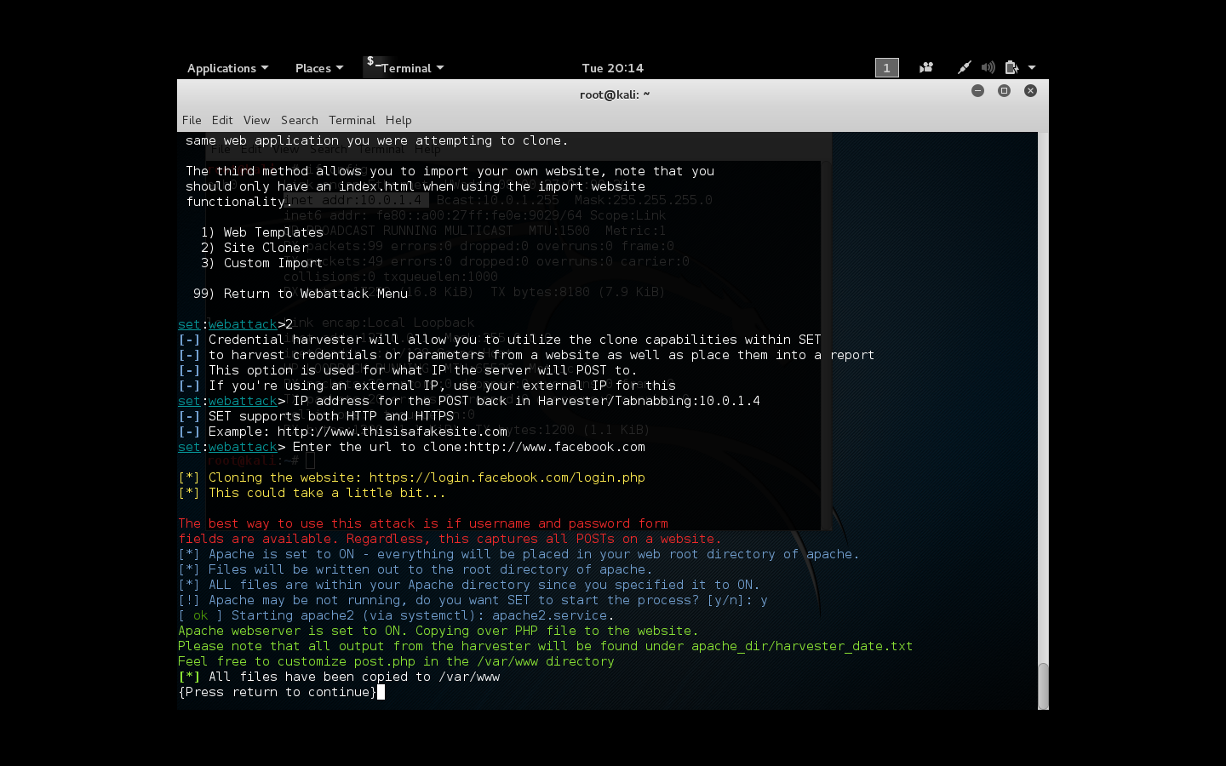

Slide 22
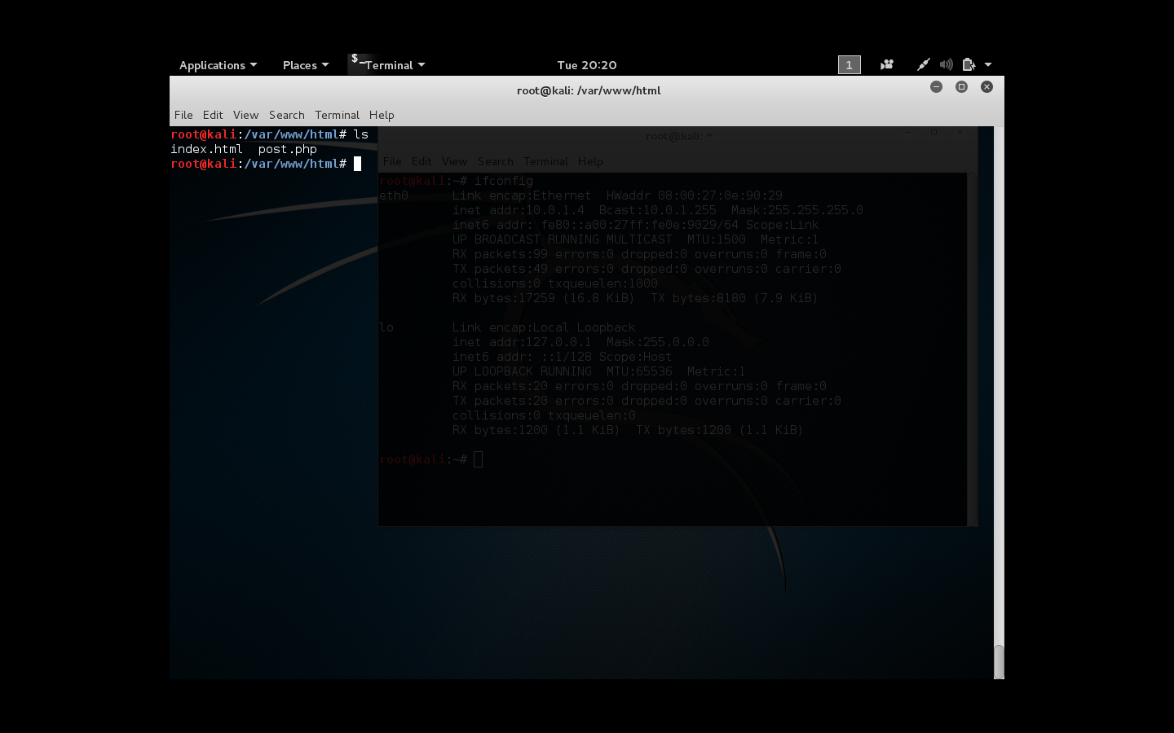

Slide 23
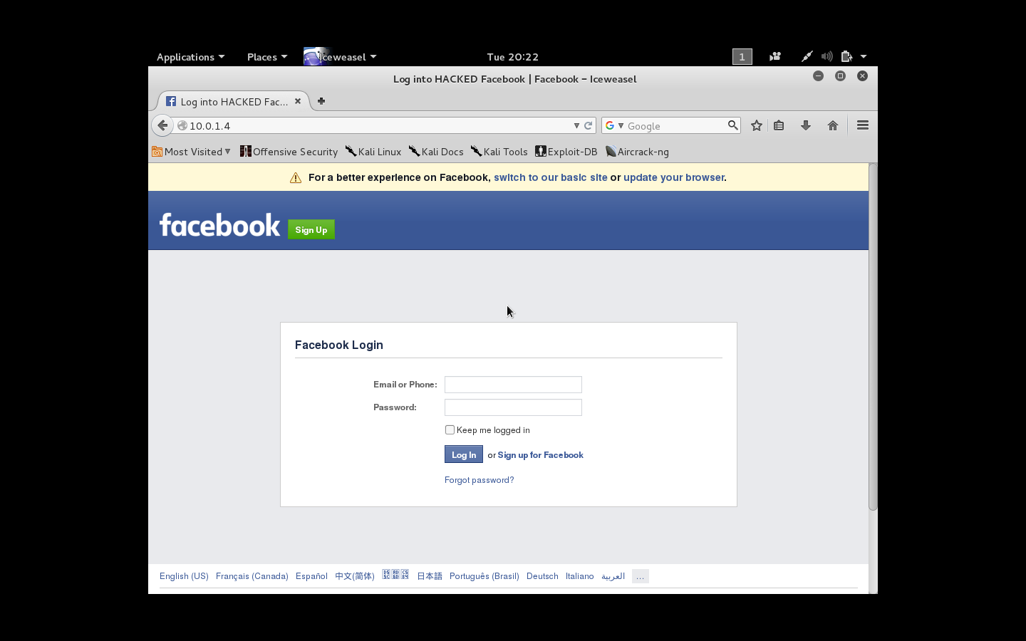

Slide 24
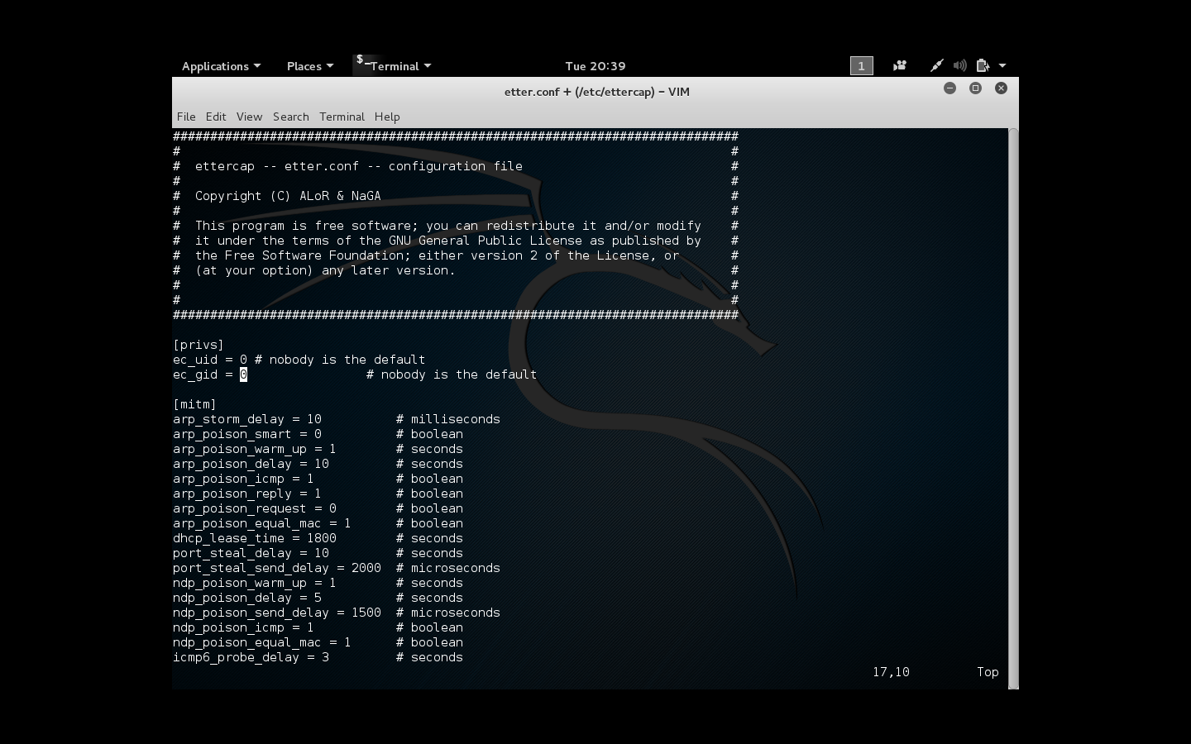

Slide 25
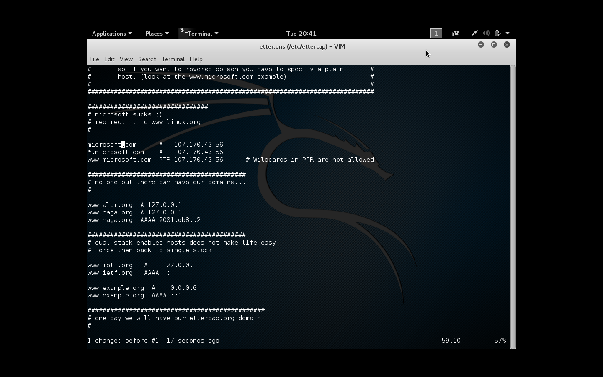

Slide 26
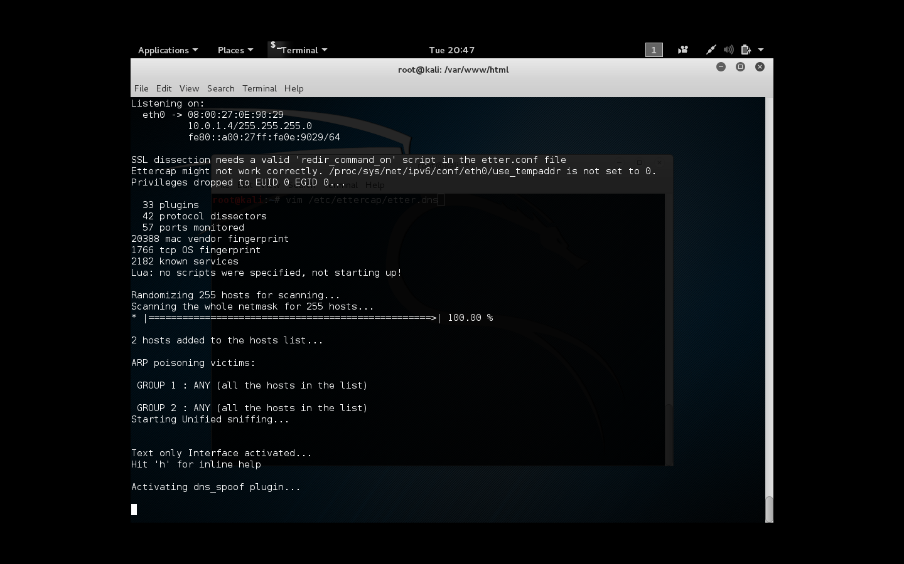

Slide 27
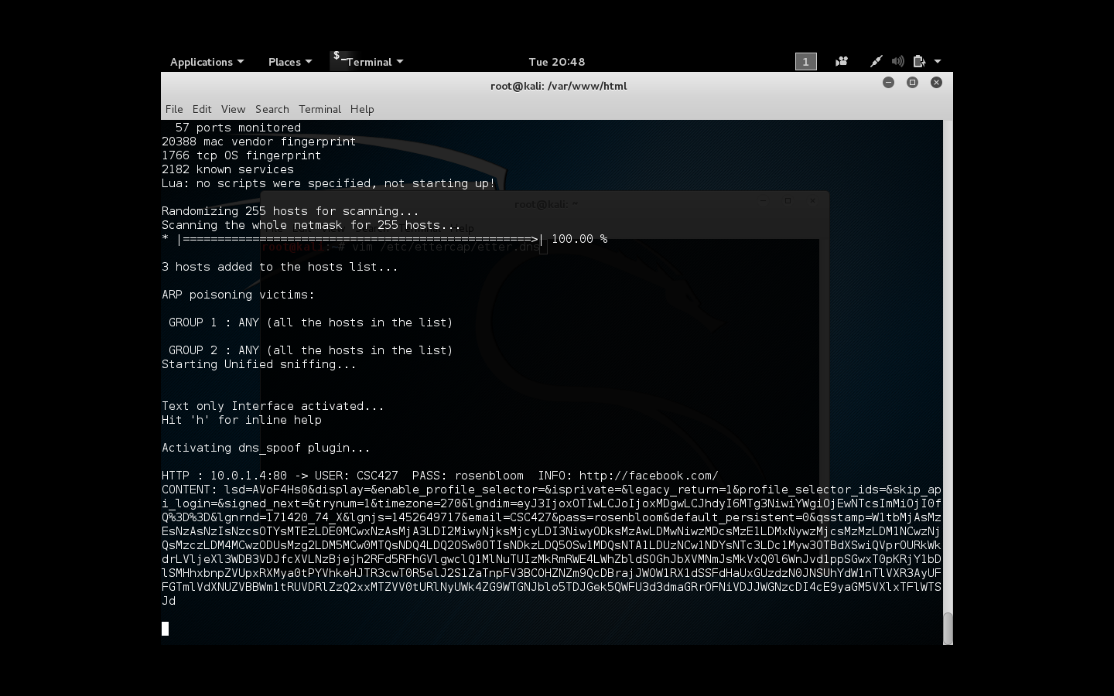

Slide 28
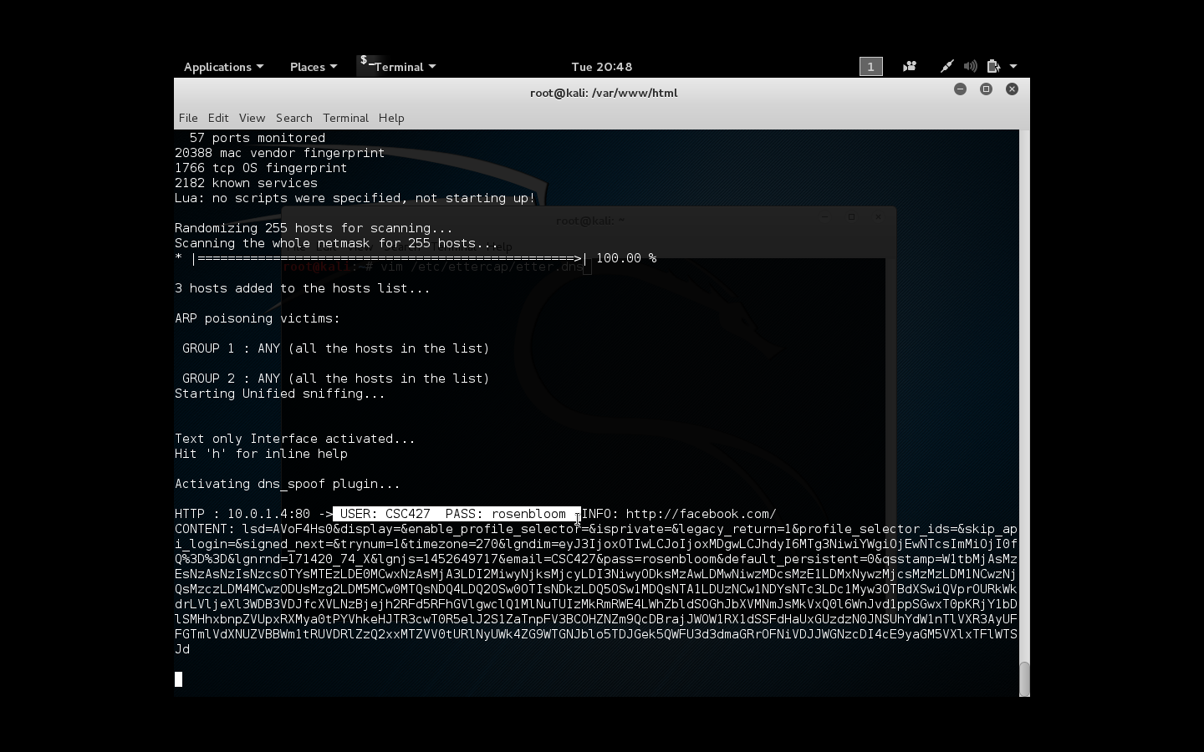

Slide 29
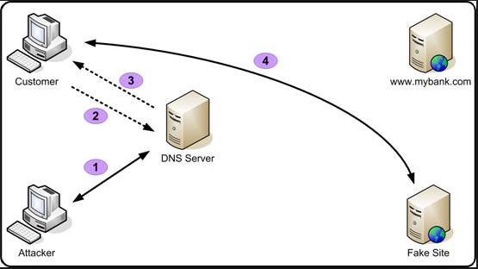
Notes:
This is a visual of what we did. Ettercap is a comprehensive suite for man in the middle attacks. Ettercap did an ARP attack which allowed us to do a DNS spoof. All the devices that are connected to network have an ARP cache. This cache contains the mapping of all the MAC and IP address for the network devices this host has already communicated with. ARP protocol was designed to be simple and efficient but a major flaw in the protocol is lack of authentication.

Slide 30
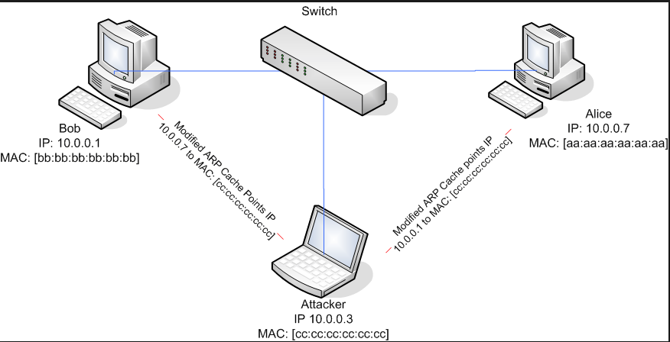
Notes:
For ettercap to achieve this suppose your machine is host “customer” and your network router is “DNS Server”. “Customer” has IP-A and MAC-A, while “DNS server” has IP-B and MAC-B as IP address and MAC address respectively. Now, the hacker sends an ARP reply to the router mapping your IP (IP-A) with his machine’s MAC address and another ARP reply to your machine mapping routers IP with his machine’s MAC address. Now any message sent by your machine to router or from router to your machine will reach the hacker’s machine. The hacker can now switch on the ‘IP forwarding’ feature on his machine which lets the hacker’s machine to forward all the traffic to and from to your machine and router. This way the hacker’s machine sits right in the middle and can sniff or block the traffic.

Slide 31
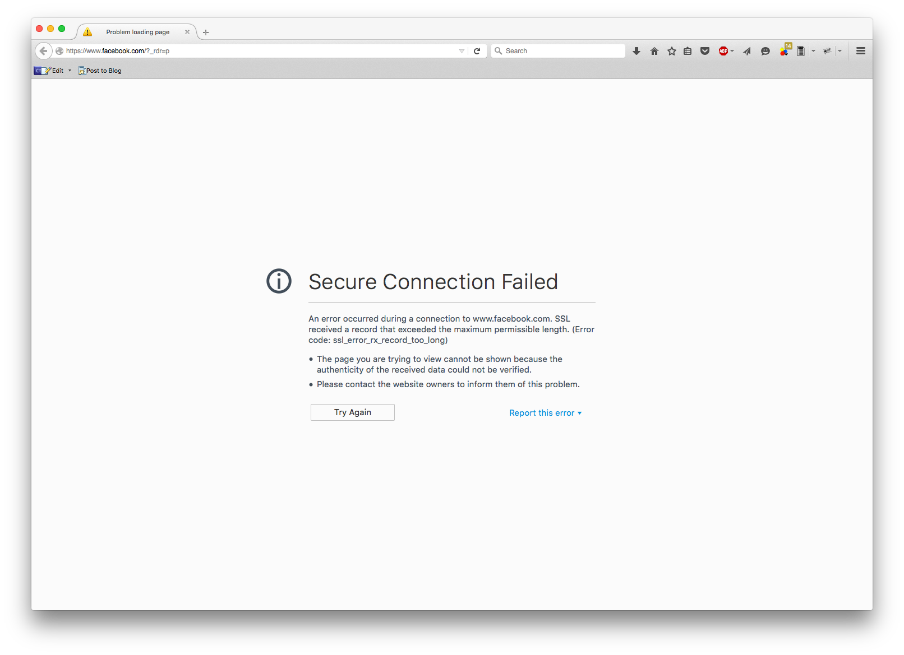
Notes:
However if we have an https in front of Facebook, it doesn’t work. This is because we don’t have a certificate and the browser can’t authenticate our website

Slide 33
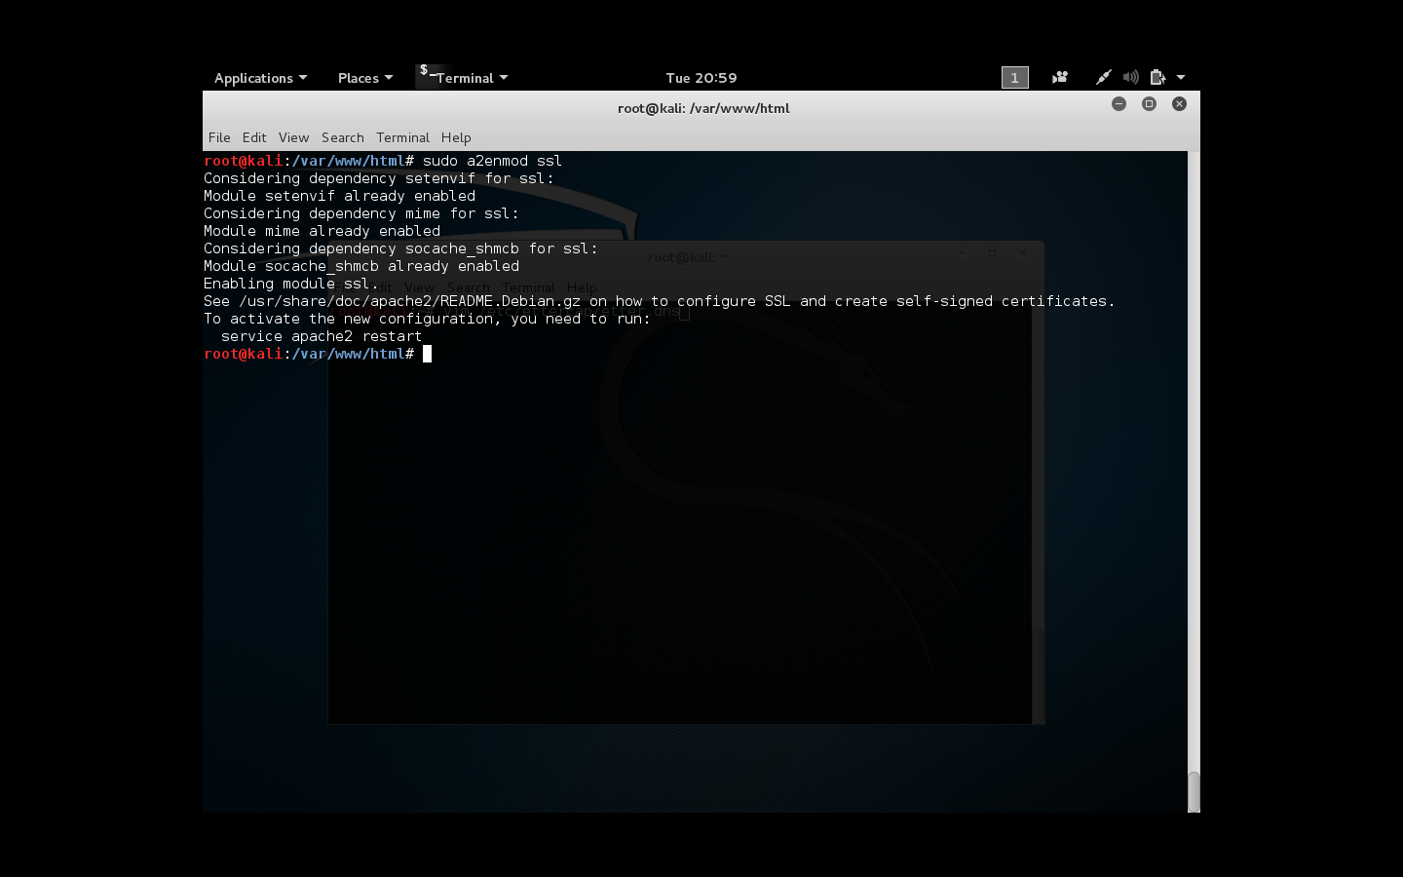

Slide 36
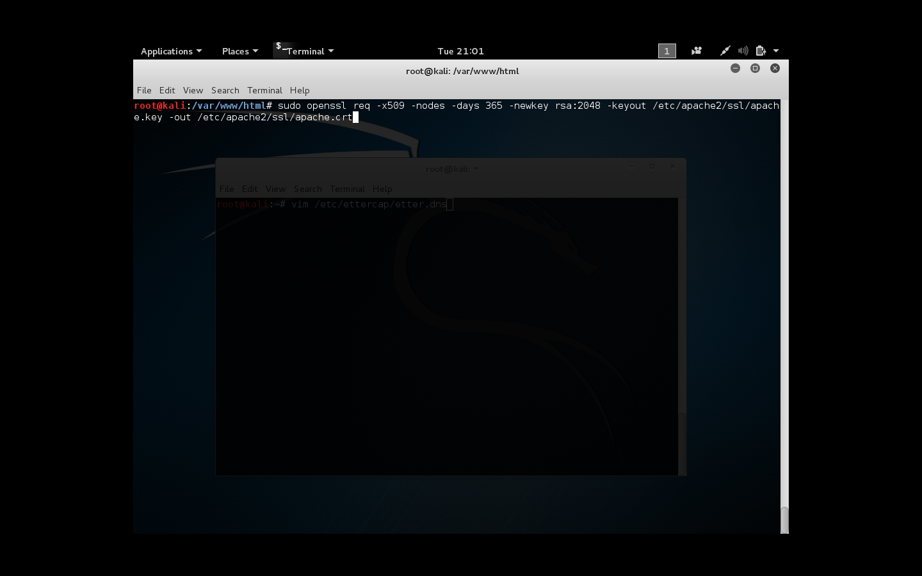

Slide 38
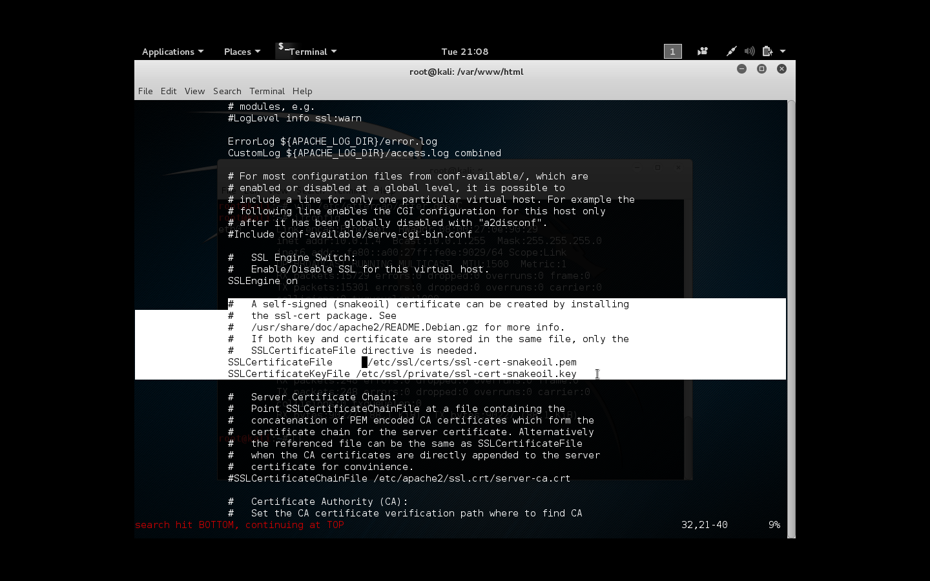

Slide 39
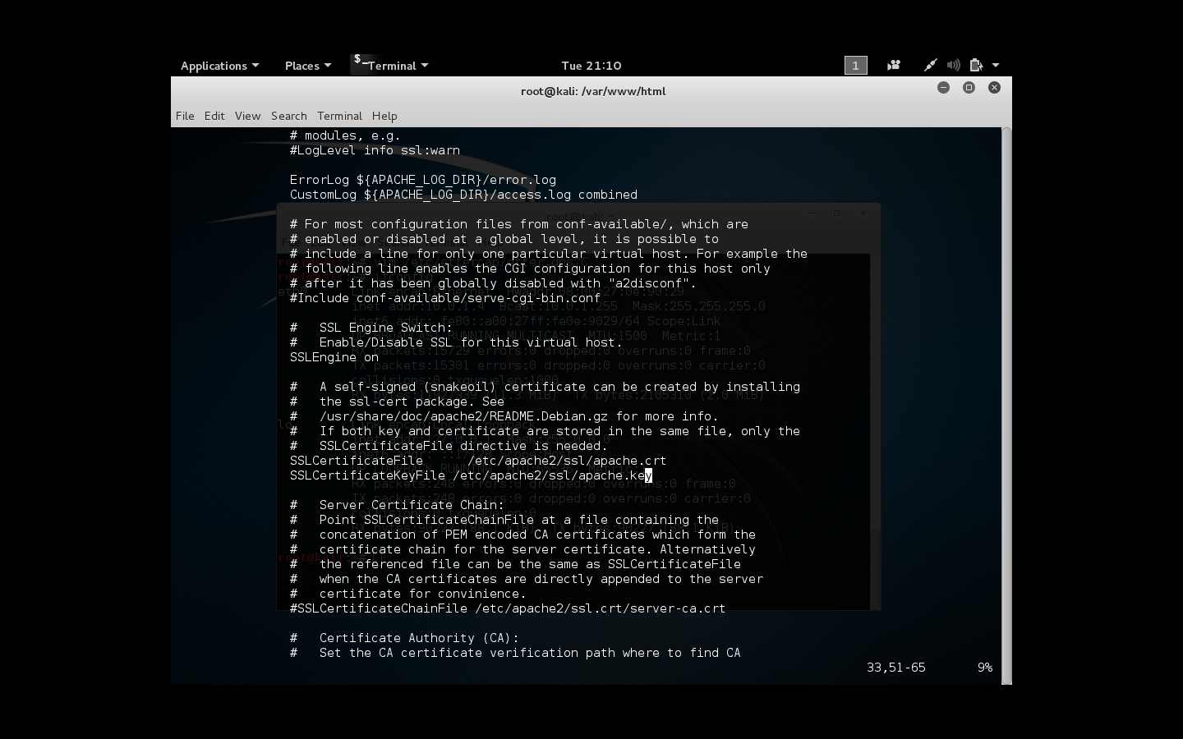

Slide 40
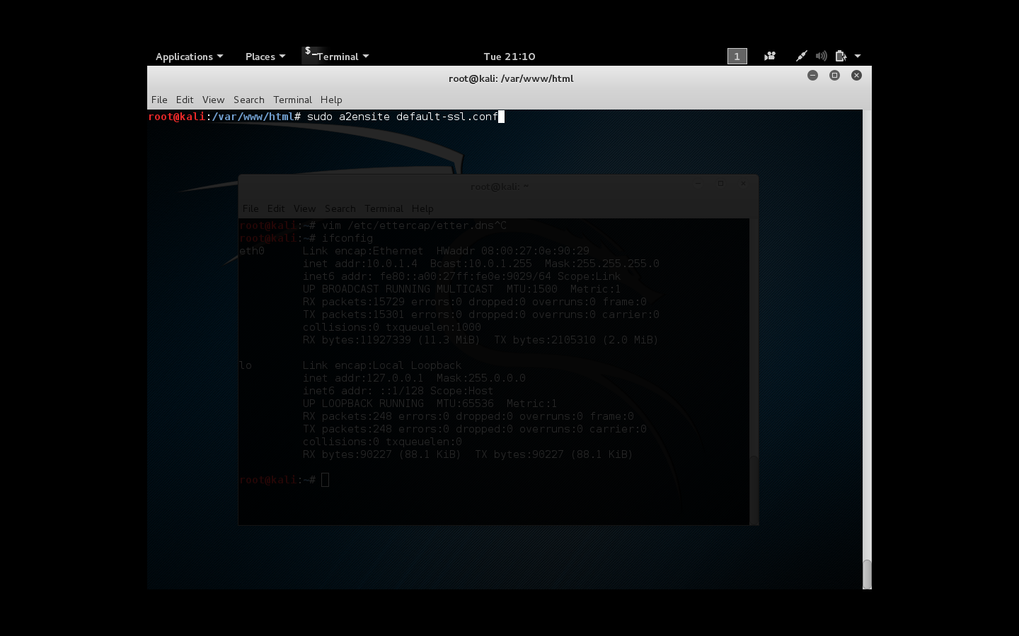

Slide 41
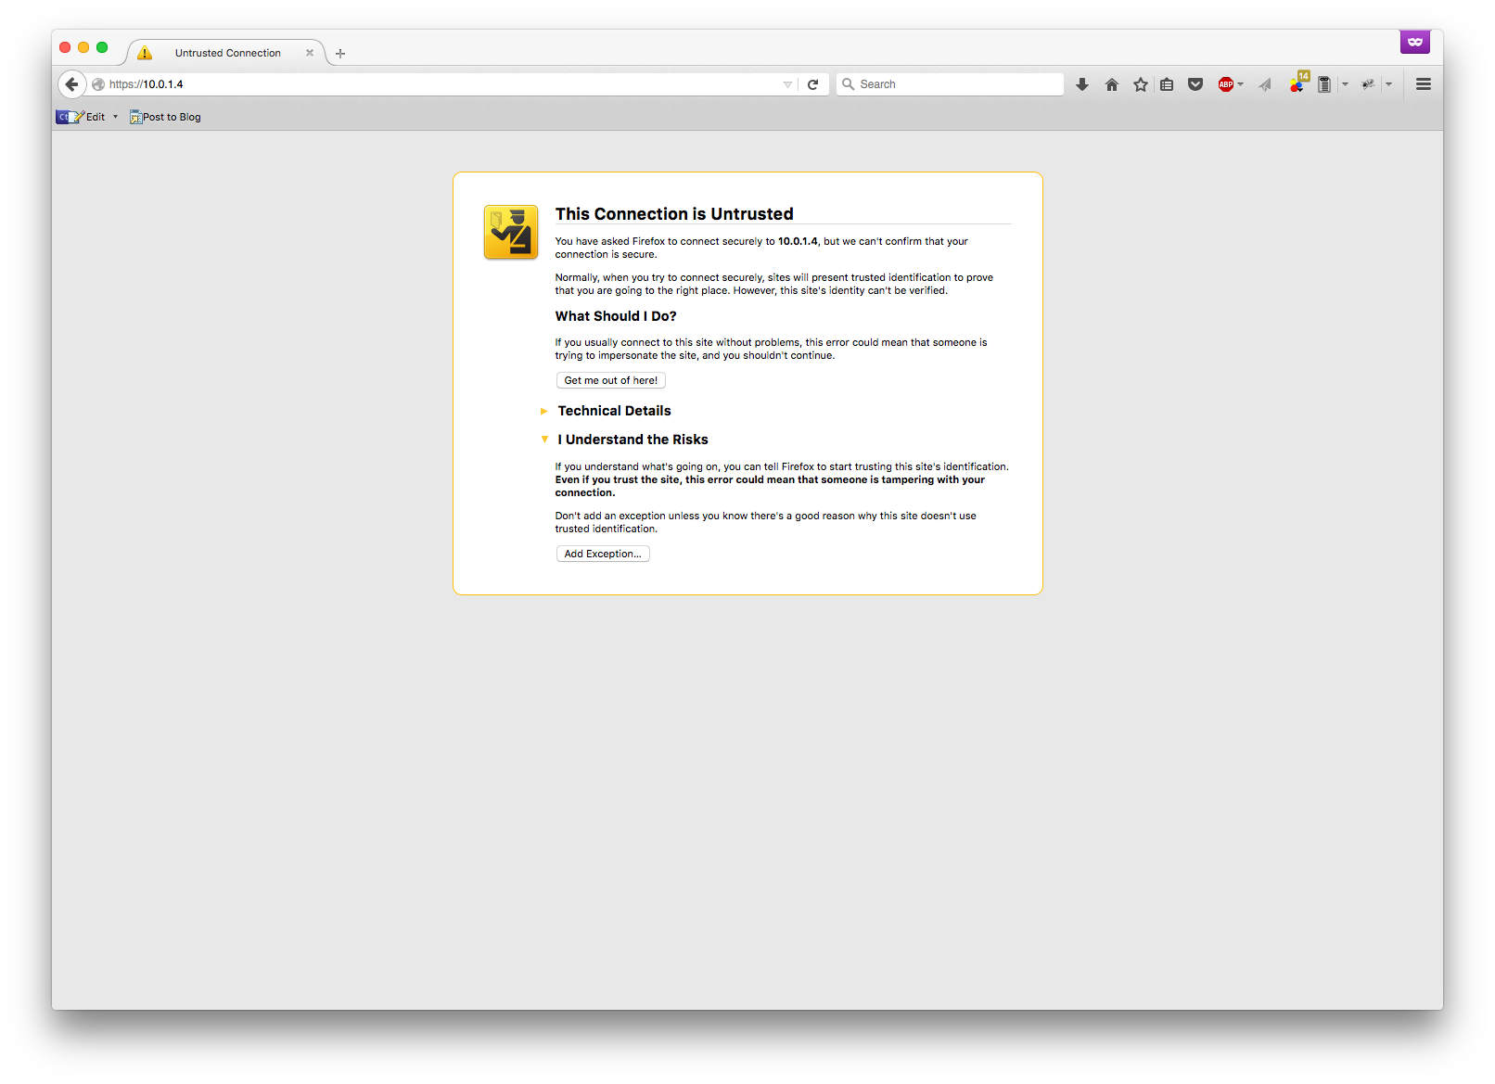
Notes:
I’m sure many of you have seen this before, unfortunately many people add the exception in order to access the website which could be dangerous.

Slide 42
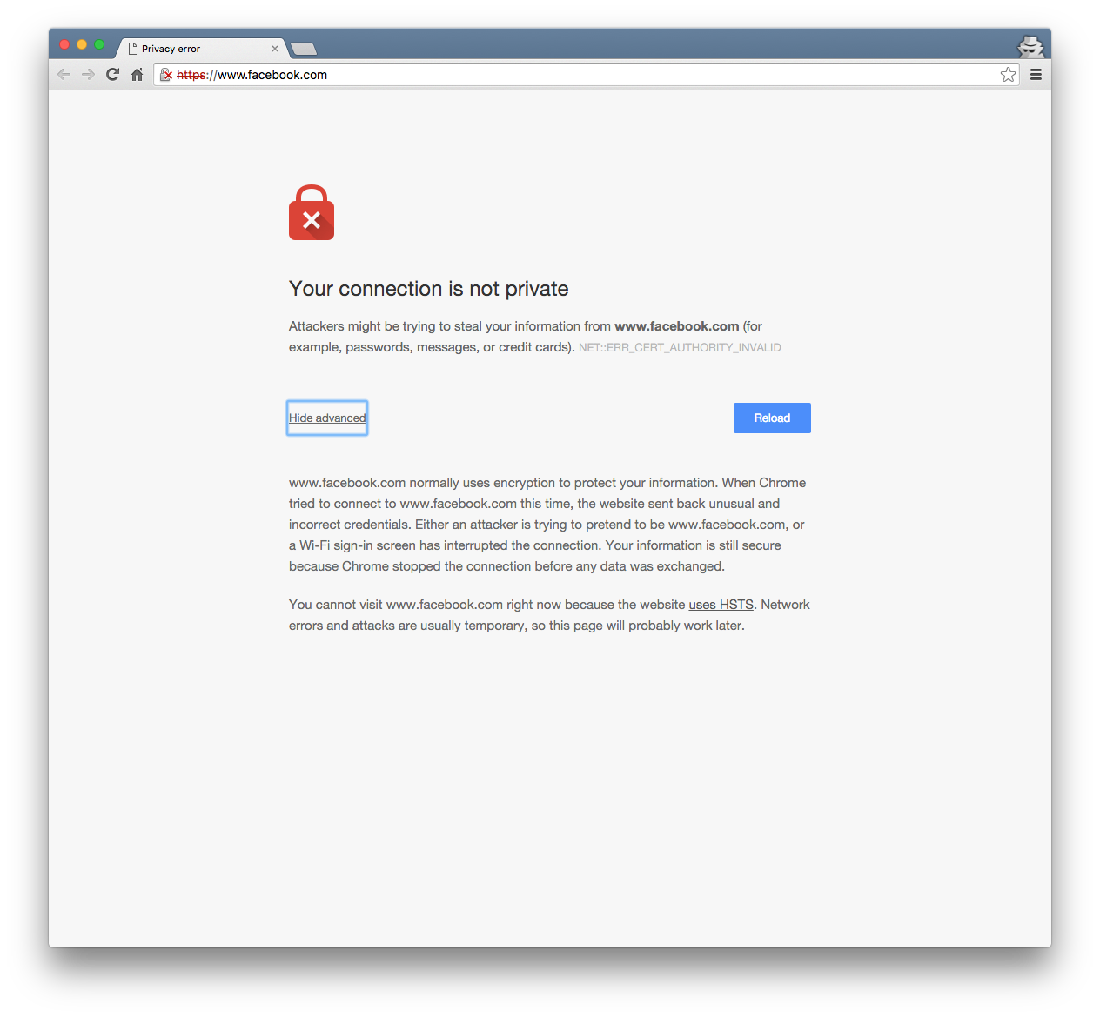
Notes:
But google chrome stops us from moving any further because the facebook uses HSTS which blocks our attempt at spoofing the page. This will be discussed a bit later

Slide 43
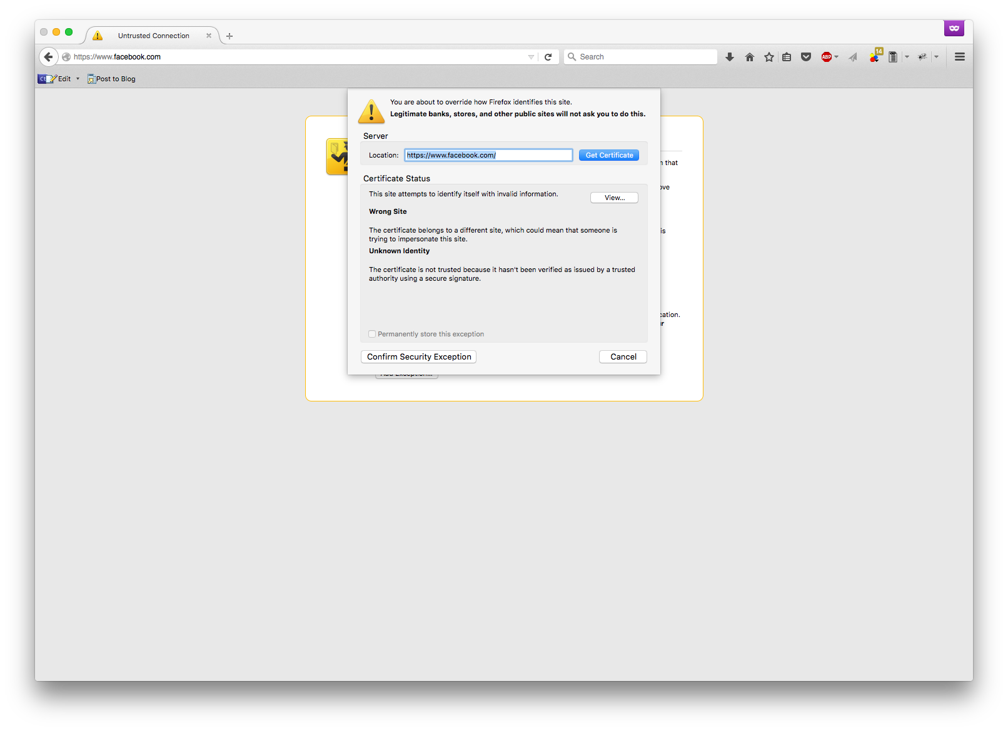

Slide 44
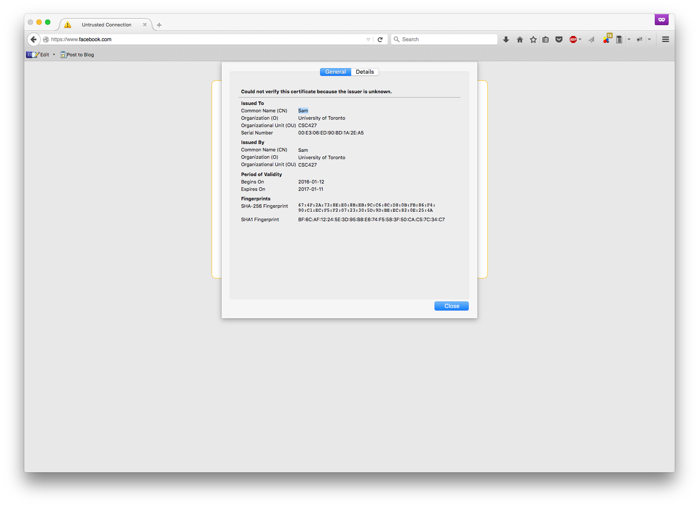

Slide 45
Impact of DNS Spoofing
DNSSEC still doesn’t protect from DDoS
Attack can be long running without being noticed
Usernames and passwords
Theft of intellectual property if secure emails are sent to unauthorized mail servers
If DNS cache poisoning is successful, the above effects can be multiplied for all users who rely on that DNS server.

Slide 46
Detection of DNS Spoofing
Chrome shows HTTP Strict Transport Security HSTS
Certificates
Notes:
- HSTS prevents a type of man-in-the-middle attack called a protocol downgrade attack. We experienced this when we tried to redirect https://facebook.com to http://facebook.com. There are tools like mitmf that can be utilized to ‘strip’ ssl off of these protection mechanisms.
HSTS is implemented in the header of an HTTP response but can be stripped it is the first visit to the site if it uses HTTP.
HSTS is also time limited (max 1 year) so it is vulnerable to attacks where the victim computer’s time can be changed.
If expected certificates don’t match, a warning is usually issued to provide preliminary detection

